Slide 1
Inferential Statistics
&
Applied Probability
Course Code: DS221
Credits: 3
Instructor: Muhammad Sajid Ali

Slide 2
Team Code
5jzpk31

Slide 3
Textbooks
Probability and Statistics for Computer Scientists, Third Edition, By Michael Baron.
Probability for Computer Scientists, online Edition, David Forsyth
Probability and Statistical Inference" by Robert V. Hogg, Elliot A. Tanis and Dale L. Zimmerman

Slide 4
Grading Criteria
Assignments, Projects, Case Studies 15 – 20%
Quizzes 10%
Midterm 30%
Final 40%

Slide 5
Teaching Methodology
Lectures
Quizzes
Assignments
Projects
Demos

Slide 6
Basic Lecture Methodology
Handouts,
Power point presentations
White board, and
Active class discussions

Slide 7
Queries and Information
I’ll be available for student’s queries and information during prescribed office hours.
Instructor Email
sajid.ali@giki.edu.pk

Slide 8
Office Hours
To be announced

Slide 9
Inferential Statistics
&
Applied Probability

Slide 10
Statistics is?
The analysis and interpretation of
data, where the set of observations is
called a “dataset” or “sample”

Slide 11
Statistics – Example - I
Class Performance
Let’s say test scores of five students:
70, 80, 90, 85, and 75.
What statistics can do: You can calculate the average score (80) to get an idea of how well the class performed overall.

Slide 12
Statistics – Example - II
Income distribution in a community
Consider the following income of few individuals:
50000 , 80000 , 85000, 95000, 150000
What statistics can do: You can calculate the median (85000) that represents the typical income for most people in the community

Slide 13
Statistics – Example - III
Favorite Ice Cream Flavor
Consider the following responses from friends on their favorite ice cream flavor:
  Vanilla, Chocolate, Vanilla, Strawberry, Chocolate, Vanilla.
What statistics can do: You can find the most popular flavor.
  Most Frequent Flavor (Mode): Vanilla appears most often, so it's the popular flavor among friends.

Slide 14
Statistics – Example - IV
Heights of Students: Imagine you’re responsible for designing or ordering school uniforms for a class of students. You need to ensure that the uniforms will fit all students comfortably.
Any thought on how statistics can help?

Slide 15
Statistics – Example - IV
Heights of Students
Let's say you measure the heights of five students:
  150 cm, 160 cm, 155 cm, 165 cm, and 170 cm.
What statistics can do: You can find how much the heights vary by calculating the range.
  Range = 170 cm − 150 cm = 20 cm.
You can determine that you need to provide uniforms in a variety of sizes to accommodate both the shortest student (150 cm) and the tallest student (170 cm).

Slide 16
Statistics – Data Types
Have you observed the data types (categorical or numerical) involved in our previous examples?

Slide 17
Statistics – Data Types
Class Performance (Test Scores)
  Data type: Numerical
Favorite Ice Cream Flavors
  Data type: Categorical
Heights of Students
  Data type: Numerical

Slide 18
Statistics – Data Types
Categorical (nominal)
  Smoker or non-Smoker, Female or Male
Categorical (ordinal)
  Not satisfied, satisfied, very satisfied
Numerical (discrete)
  1, 2, 100, 20, 30 …
Numerical (continuous)
  0.15, 1.3342, 100.34 …

Slide 19
Statistics – Data Types
Which of the following data is not categorical?
Number of enrolled students in a class
Weight of apples in a grocery store
Instruments played by an orchestra
Type of chemical reagents in a lab
A & B

Slide 20
Statistics – Data Types
Which of the following data is not categorical?
Number of enrolled students in a class
Weight of apples in a grocery store
Instruments played by an orchestra
Type of chemical reagents in a lab
A & B

Slide 21
Statistics – Data Types
What kind of data is a letter grade?
Categorical (nominal)
Categorical (ordinal)
Numerical (discrete)
Numerical (continuous)

Slide 22
Statistics – Data Types
Any thoughts on
Why is it important to identify the type of the data?

Slide 23
Statistics – Data Types
Any thoughts on
Why is it important to identify the type of the data?
Reason: different data types require different analysis methods (see prev. examples)

Slide 24
Two Sides of Statistics
Descriptive statistics
  Organizes and summarizes data using numbers and graphs.
  Example: Average customer rating, total number of clicks on a page.
Inferential statistics
  Makes predictions or inferences about a population based on a sample data
  Example: Predicting future sales based on current data.

Slide 25
Two Sides of Statistics
Important
  How can we use a small sample to make decisions about a larger population?
  That’s the power of inferential statistics, which we’ll explore later that how it uses probability to determine how confident we are about the prediction.

Slide 26
Descriptive Statistics
Your thoughts on the meaning of
Organizing and summarizing the data?

Slide 27
Descriptive Statistics
Organizing data – is about structuring and arranging the data so that it’s easy to work with. This may include:
  Sorting data – Sort students test scores from highest to lowest.
  Grouping data – group survey responses by ice cream flavor, such as Vanilla, Chocolate, and Strawberry.
  Creating tables – organize data into a table with rows for individuals or categories and columns for different variables, like names, test scores, and favorite ice cream flavors.

Slide 28
Descriptive Statistics
Summarizing data – means reducing the data to key figures or visualizations that capture the essence of what the data shows. This may include:
  Calculating mean
  Finding median
  Creating graphs

Slide 29
Descriptive Statistics
Let’s see how descriptive statistics organizes and summarizes data?
Using numbers
  Measures of Central Tendency: These include statistics like
    Mean (average)
    Median (middle)
    Mode (most frequent value)
  Which summarize the central point of a dataset. (see previous examples)

Slide 30
Descriptive Statistics
Let’s see how descriptive statistics organizes and summarizes data?
Using numbers
  Measures of Spread: These include statistics like
    Range
    Variance
    Standard deviation
  Which describe how much the data varies or spreads out. (see previous examples)

Slide 31
Descriptive Statistics
Let’s see how descriptive statistics organizes and summarizes data?
Using graphs – visually summarize data, revealing patterns and trends
  Bar charts
  Histograms
  Pie charts
  Box plots

Slide 32
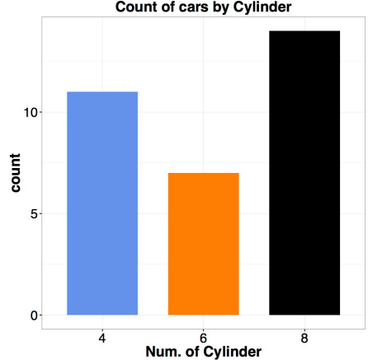
Descriptive Statistics
Bar Chart – used to represent categorical data, showing the frequency or percentage of categories
Data: “mtcars”

Slide 33
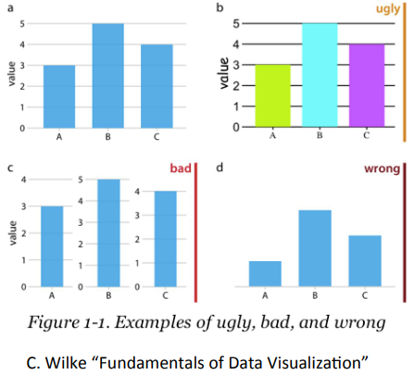
Descriptive Statistics
The difference between good, ugly, bad and wrong visualization of graphs

Slide 34
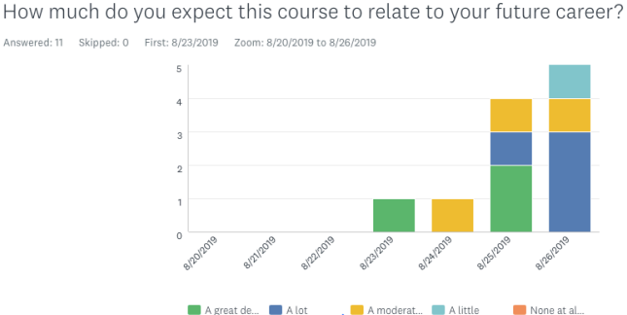
Descriptive Statistics
An example of clustered bar chart.
Question: Is this a good bar chart?

Slide 35
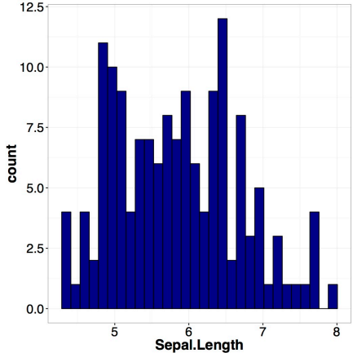
Descriptive Statistics
Histogram – Used for numerical data, showing the distribution of data across different intervals (bins)
Data: “iris”

Slide 36
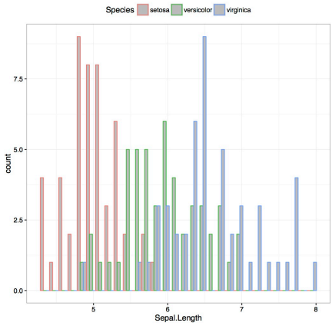
Descriptive Statistics
Histogram – Used for numerical data, showing the distribution of data across different intervals (bins)
Data: “iris”
Histogram generated by the subsets of the dataset

Slide 37
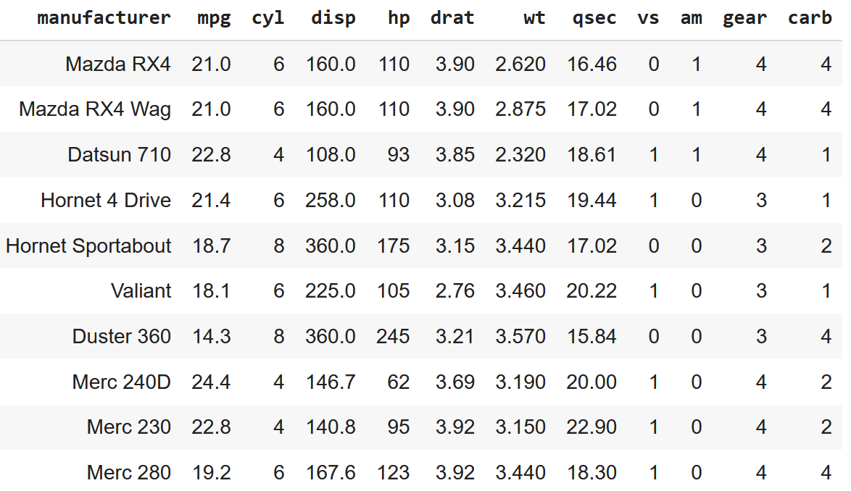
Descriptive Statistics – Demo
Data visualization and summary
  In datasets {x} – a set of N items X_{i}, i = 1…N, each of which is a tuple
Columns
Tuple

Slide 38
Descriptive Statistics – Demo
Convention: columns are the features; the number of features is dimension.
Car features
Cars
Each row is a tuple with dimension = 11

Slide 39
Descriptive Statistics – Demo
Let’s see Demo in action.

